Slide 1

Knowledge Distillation for Smaller Models in Computer Vision Final Project Presentation
Spring 2025, CSE 5368 – Neural Networks
Wonjun Park, Abhinay Kotla
April 26th, 2025
Notes:
Good afternoon, everyone
I’m Wonjun, a Master student in Computer Science,
Today, we will present about
Knowledge Distillation for Smaller Models in Computer Vision.
Let’s get started.

Slide 2
Acronym and Abbreviation
Convolutional Neural Network (CNN)
Residual Neural Network (ResNet)
FP (Floating Point)
DiffIR (Diffusion Model for Image Restoration)
Notes:
This is Acronym and Abbreviation of today’s presentation,

Slide 3
Content
Background
Knowledge Distillation
Quantization
Obstacle
Methodology
Intel Image Dataset
Model Architecture
Experiment
Performance Analysis
Notes:
and here’s the content
I will describe what knowledge distillation and quantization are,
and introduce our story during the project.
And my colleague presents the methodology and experiment of our project.

Slide 4
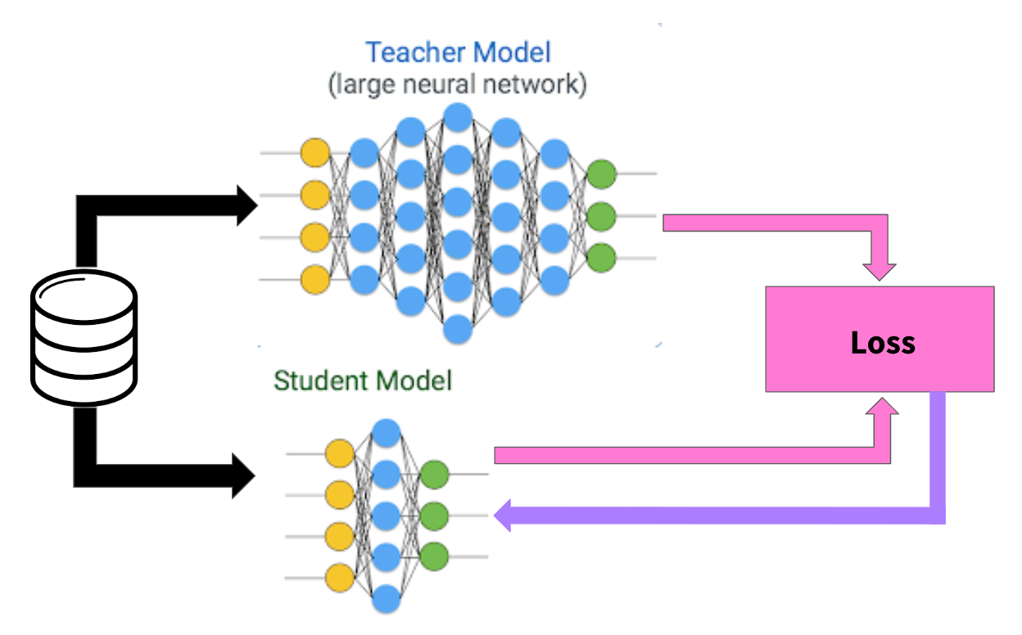
Background Knowledge Distillation
[1] Prakhar Ganesh, 2019, Knowledge distillation: Simplified.
Notes:
Knowledge Distillation basically refers to Teacher-Student training.
Let’s imagine a very large model like Llama 70B.
It’s impossible to train it, on a normal GPU that has normally 6-8GB.
However, for the inference, we might be able to run on our GPU,
because we do not need to calculate gradients.
Also the model like Llama, has a superiority
that many data points that normally hard to access
was used.
So what knowledge distillation do is
during the training of the smaller model that can be trained on the small GPU,
freezing the large model and make the large model inference it.
Than, the small model trains the answer of the large model,
mimicing the distribution of the large model.

Slide 5
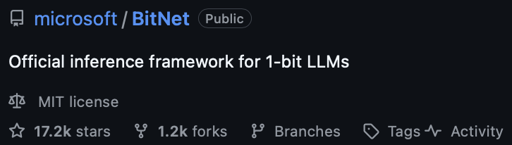
Background Quantization
[3] Hongyu Wang, et al., 2023, arXiv
Data Type | dtype
64-bit floating point | torch.float64 or torch.double
32-bit floating point | torch.float32 or torch.float
16-bit floating point | torch.float16 or torch.half
8-bit floating point | torch.float8_e4m3fn or torch.float8_e5m2
[2] torch.Tensor, PyTorch 2.7 documentation
Notes:
Quantization is a technique that addresses the precision of the number representation.
The the bit of the precision becomes smaller,
the calculation speed and the size of the model becomes smaller.
Conversely, if the bit of the precision becomes larger,
the calculation speed becomes slower and
the performance of the model might be increased due to the increase of the detail in the number representation.
Normally, PyTorch calculates the number as 32-bit floating point.
and we can choose what data type we will use during the pytorch calculation.
As an example, BitNet is an ongoing project that Microsoft develops.
It’s really fast and can run on the CPU as well.
What we need to concentrate on here is a demand to make a model smaller.

Slide 6
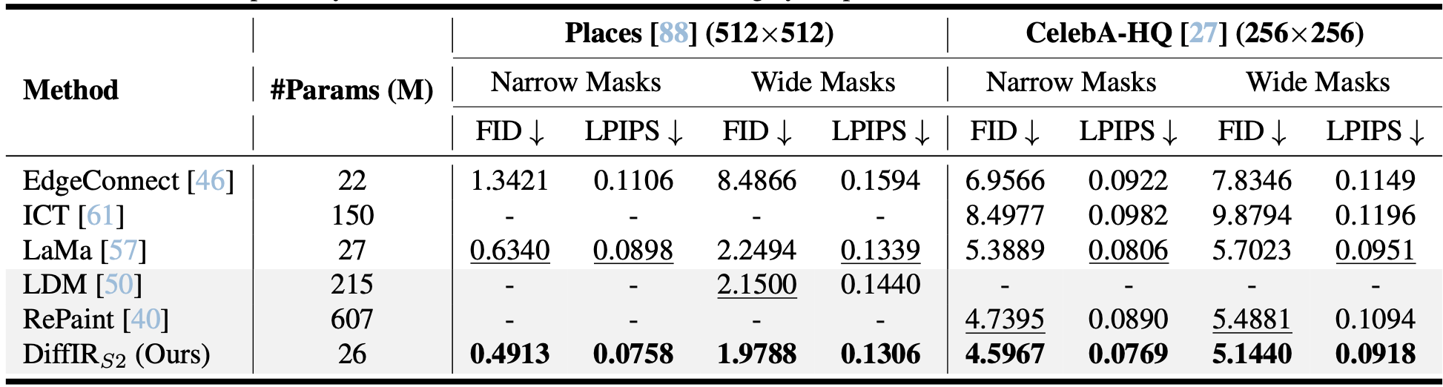
Obstacle
Knowledge Distillation on Image Inpainting
DiffIR [11] (Bin Xia, et al., 2023, ICCV)
Problem
Notes:
We firstly planned our project topic as Knowledge Distillation on Image Inpainting.
After searching about the topic, we found DiffIR,
quite small model than others, but shows the best performance.
However, the problem was, it still requires quite a lot computational resources.
The snapshot shows the required time to train DiffIR when using 8-bit quantization.
Note that, like I said before, 8-bit quantization makes the calculation faster.
So we shrink the range of the topic to the simpler task in Computer Vision
to show the effectiveness of our Knowledge Distillation framework.

Slide 7
Methodology, Experiments, and Results
Notes:
Thanks for the introduction. From here, I’ll walk you through the core implementation, the models we designed, and the experiments we ran to evaluate our approach.
Specifically, I’ll be focusing on two main parts:
The methodology we used — including dataset, model architectures, and how we implemented knowledge distillation and quantization.
The experiments and results — showing performance trends, insights, and what we found effective.
Let’s begin with a quick overview of the dataset.

Slide 8
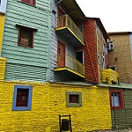
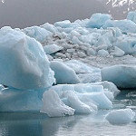

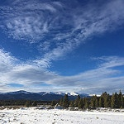
Intel Image Dataset
25,000 RGB images at 150 × 150 resolution
6 classes: buildings, forest, glacier, mountain, sea, street
Dataset split:
~14,000 images for training
~3,000 images for testing
~7,000 images for prediction
Collected via Kaggle & Unsplash
Balanced and clean—ideal for scene classification tasks
Notes:
To train and evaluate our models, we used the Intel Image Classification Dataset, which is a publicly available dataset from Kaggle.
It contains 25,000 RGB images, each with a resolution of 150 by 150 pixels.
These images are categorized into six scene classes: buildings, forest, glacier, mountain, sea, and street — as shown in the image examples on the right.
The dataset is well-structured and split as follows:
Around 14,000 images for training,
3,000 for testing,
and about 7,000 for prediction or validation tasks.
What makes this dataset particularly suitable is that it's balanced and clean, which is ideal for training classification models without needing heavy preprocessing.
Next, let’s look at how we built our models starting with the teacher network.

Slide 9
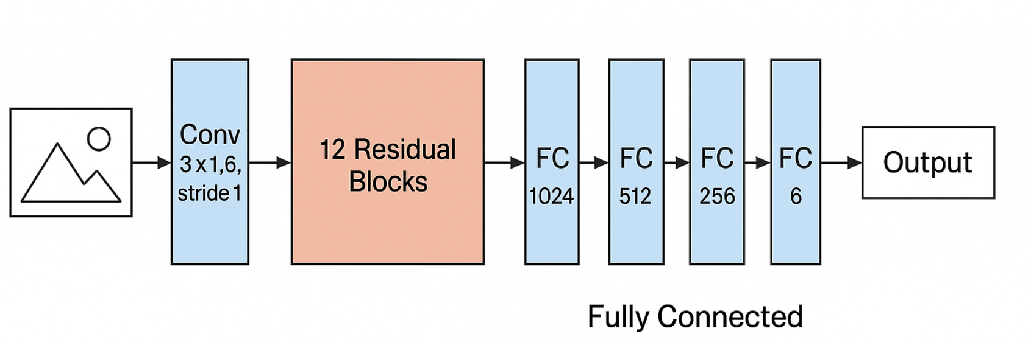
Teacher CNN Model
Built using 12 Residual Blocks (ResNet-style)
Channels double every two blocks: 16 → 1024
Fully Connected Layers: 1024 → 512 → 256 → 64 → 6
26.5M total parameters
Operates in FP32 precision
Acts as a high-capacity knowledge base for distillation
Notes:
This is the architecture of our Teacher CNN Model, which we designed to serve as the high-capacity reference for knowledge distillation.
It starts with a convolutional layer that processes the 3-channel RGB input image, followed by 12 residual blocks, structured in a ResNet-like fashion. These blocks progressively increase the channel depth, doubling approximately every two layers—from 16 all the way to 1024.
After feature extraction, we use a fully connected classifier consisting of several dense layers: 1024 → 512 → 256 → 64 → 6, where 6 corresponds to our output classes.
Altogether, the model has about 26.6 million parameters and is trained in FP32 precision.
This teacher network is not trained alongside the student—it’s pretrained and then used to guide the student model using both hard and soft labels. I’ll explain how that works shortly

Slide 10
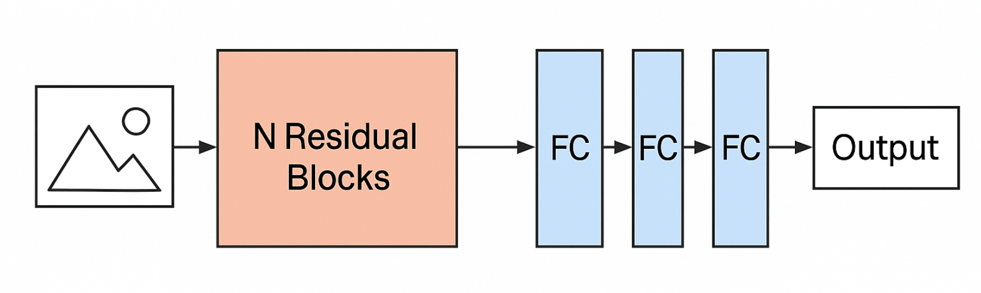
Student Model Variants
Aim: Reduce model size while retaining performance
Models created with: 10, 8, 6, and 4 residual blocks
Parameter counts:
10-block: 6.6M
8-block: 1.6M
6-block: 408K
4-block: 98K
Corresponding FC layers scaled down
Use modular designs for easy experimentation
Notes:
Now let’s look at the student models — these are smaller, efficient networks that we distill knowledge into from the teacher.
The main objective here is to reduce the model size while maintaining high performance.
We created four student variants by reducing the number of residual blocks. We tested models with 10, 8, 6, and 4 blocks.
Here’s how the number of parameters drops:
10-block model: around 6.6 million
8-block model: 1.6 million
6-block model: 408 thousand
And the smallest 4-block model: just 98 thousand parameters
Along with these, we scaled down the fully connected layers proportionally to match the reduced feature complexity.
All these models were implemented using a modular design, making it easy for us to plug in different configurations and experiment with structure and performance trade-offs.

Slide 11
ModularCNN Architecture
Parametrized Design: Specify number of residual blocks and FC layers at model instantiation.
Dynamic Feature Size: Uses a dummy input to auto-determine flattened feature size.
Scalable Residual Blocks: Adds blocks with doubling channels every 2 layers.
Flexible FC Layers: FC layers built in a loop with ReLU, BatchNorm, and Dropout.
Reusable & Lightweight: Enables fast prototyping of student models with varying depth and width.
Notes:
Rather than manually defining each student model variant, we implemented a ModularCNN architecture that lets us dynamically configure the number of residual blocks and fully connected layers.
At its core, the model starts with a convolutional layer and a batch normalization layer, followed by a stack of residual blocks — the number of which is passed as a parameter when instantiating the model.
To make the design more scalable, the model also includes an adaptive pooling layer to reduce feature map size, followed by a flexible fully connected block. The fully connected layers are built in a loop and progressively reduce dimensionality using linear layers, ReLU, batch normalization, and dropout.
What’s really useful is that we determine the flattened feature size dynamically at runtime using a dummy input, so we can plug in any number of residual layers and it just works.
This modular approach allowed us to easily experiment with different student capacities — from lightweight networks with just a few blocks to deeper versions — without rewriting architecture code for each.
Next, I’ll show how we trained these student models using knowledge distillation and precision quantization.

Slide 12
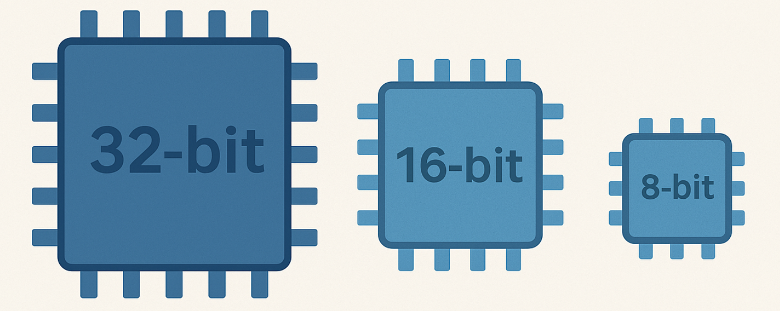
Precision Quantization
Tested under FP32, FP16, and FP8
Used bitsandbytes for 8-bit training
Objective: Lower training time and memory usage
Precision set via torch.set_default_dtype()
Key benefit: FP16 offers best trade-off between speed and accuracy
Notes:
To further optimize our models for training efficiency and memory usage, we tested them under three different numerical precisions: FP32, FP16, and FP8.
For FP8 quantization, we used the BitsAndBytes library, which allows us to run 8-bit optimizers and inference with minimal accuracy degradation.
Our objective here was to find the best trade-off between speed and performance.
FP32 gave us the most stability,
FP8 helped significantly reduce memory consumption,
But it was FP16 that consistently offered the best balance — achieving fast training while still maintaining high accuracy.
We configured precision modes dynamically using PyTorch’s torch.set_default_dtype() function before training each experiment.
The visual here illustrates the relative memory footprint of each format — smaller bit-widths help reduce GPU memory usage, which is essential when training on limited hardware or scaling to multiple models.

Slide 13
Distillation Setup
Training: Student learns from teacher’s soft predictions
Loss = 0.5 * CE Loss + 0.5 * KL Divergence
Temperature = 4.0 for softening distributions
Optimizer: Adam or Adam8bit depending on precision
Early Stopping (Patience: 3 epochs)
Hardware: NVIDIA RTX 4070 Laptop GPU
Batch Size: 224
Notes:
This slide explains how we implemented the knowledge distillation process.
During training, the student model learns from the teacher model’s soft predictions — which are more informative than one-hot labels because they contain relative class probabilities.
We use a blended loss function that combines:
Cross-Entropy Loss, which compares the student’s predictions to the ground-truth (hard labels), and
KL Divergence, which compares the student’s output distribution to the teacher’s soft predictions.
Each component is weighted equally with α = 0.5, and we apply a temperature of 4.0 to soften the teacher’s output probabilities before comparison.
Our optimization strategy used either Adam or Adam8bit depending on the selected precision (e.g., FP8 uses 8-bit Adam).
To prevent overfitting, we added early stopping with a patience of 3 epochs.
All experiments were conducted on an NVIDIA RTX 4070 Laptop GPU, using a batch size of 224 for efficient GPU utilization.

Slide 14
Teacher Model Baseline Performance
Accuracy: 85.77%
Train Time/Epoch: 72.32 sec
Params: 26,534,358
Notes:
This slide shows the performance of our teacher model, which serves as the knowledge source for student models during distillation.
We used a deep CNN architecture with 12 residual blocks and progressively increasing channel sizes, ending with fully connected layers of size 1024 → 512 → 256.
The model achieved a test accuracy of 85.77%, which serves as our benchmark for evaluating student models.
Each epoch of training took about 72.32 seconds on the NVIDIA RTX 4070 Laptop GPU.
The total number of trainable parameters in the teacher model is around 26.5 million, making it computationally expensive but accurate.
This strong baseline allows us to evaluate how well our compact student models can approximate its performance under various compression strategies.

Slide 15
Weight Reduction Impact
Student Model | Accuracy | Params | Time/Epoch
10 Blocks | 83.23% | 6.6M | 68.6s
8 Blocks | 86.43% | 1.6M | 67.0s
6 Blocks | 85.77% | 408K | 66.7s
4 Blocks | 84.57% | 98K | 64.7s
Notes:
This slide highlights the trade-off between model complexity and performance by comparing student models with fewer residual blocks.
As we reduce the number of blocks from 10 down to 4, we observe a consistent drop in training time and model size — from 6.6 million parameters down to just 98K.
Interestingly, the 8-block student model not only reduces parameters to just 1.6 million, but also outperforms the teacher with the highest accuracy of 86.43%.
The 6-block model closely matches the teacher at 85.77%, with only 408K parameters, which makes it a strong lightweight candidate.
Even the smallest 4-block model achieves over 84% accuracy, while training faster and with very minimal computational cost.
This clearly shows that through distillation, we can build efficient and compact models that retain — or even improve — the performance of their larger counterparts.

Slide 16
Precision Quantization Results
Precision | Accuracy | Time/Epoch
FP16 | 87.00% | 60.8s
FP8 | 86.07% | 69.0s
Notes:
This slide shows how quantization affects both accuracy and training efficiency.
We experimented with FP16 (half precision) and FP8 (8-bit precision) on the best-performing student model.
Surprisingly, FP16 achieved the highest overall accuracy at 87.00%, while also offering the fastest training time per epoch — just 60.8 seconds.
With FP8, accuracy dropped slightly to 86.07%, and training time increased to 69.0 seconds, likely due to overhead in quantization-aware operations.
Despite the slight trade-off, both formats offer excellent performance while drastically reducing memory usage and speeding up training compared to FP32.
These results confirm that precision tuning is a valuable tool for compressing models without sacrificing much in performance.

Slide 17
Conclusion
Distillation achieves significant parameter reduction
Student models perform as well as or better than the teacher
8-block FP16 student: 87% accuracy with 1.6M params
Validates distillation + quantization for real-world deployments
Framework is now ready to extend to other CV tasks like image inpainting
Notes:
To wrap up, our results show that knowledge distillation combined with precision-aware training leads to a highly efficient model pipeline.
We achieved massive reductions in parameters — from over 26 million in the teacher model to just 1.6 million in the best-performing student.
Importantly, the 8-block FP16 student model not only reduced size, but also achieved the highest accuracy of 87%, outperforming the teacher.
This validates our approach as both computationally efficient and performance-effective, making it well-suited for deployment on resource-constrained devices.
Lastly, this entire framework — modular CNN design, distillation, and quantization — is flexible and can now be extended to other vision tasks, including our next focus: image inpainting.

Slide 18
Reference
[1] Prakhar Ganesh, Towards Data Science, “Knowledge Distillation : Simplified”, 2019, https://towardsdatascience.com/knowledge-distillation-simplified-dd4973dbc764, accessed in Apr. 24th, 2025. [2] torch.Tensor, PyTorch 2.7 documentation, https://pytorch.org/docs/stable/tensors.html, accessed in Apr. 25th, 2025. [3] Hongyu Wang, et al., 2023, BitNet: Scaling 1-bit Transformers for Large Language Models, arXiv preprint arXiv:2305.14201. [4] Geoffrey Hinton, Oriol Vinyals, Jeff Dean. “Distilling the Knowledge in a Neural Network”, 2015, arXiv preprint arXiv:1503.02531. [5] Sergey Zagoruyko, Nikos Komodakis. “Paying More Attention to Attention: Improving the Performance of CNN via Attention Transfer”, 2016, arXiv preprint arXiv:1612.03928. [6] BitsAndBytes – 8-bit Optimizers and Quantization Tools for PyTorch, GitHub, https://github.com/TimDettmers/bitsandbytes, accessed Apr. 25th, 2025. [7] Intel Image Classification Dataset, Kaggle, https://www.kaggle.com/datasets/puneet6060/intel-image-classification, accessed Apr. 22nd, 2025. [8] Diederik P. Kingma and Jimmy Ba. “Adam: A Method for Stochastic Optimization”, ICLR 2015, arXiv preprint arXiv:1412.6980. [9] Microsoft Phi-2 & Phi-3: Quantized Language Models for Efficient Inference, Microsoft Research Blog, https://www.microsoft.com/en-us/research/blog, accessed Apr. 25th, 2025. [10] KL Divergence, Cross-Entropy Loss, and Temperature Scaling – Deep Learning Book, Chapter 18, Ian Goodfellow et al.

Slide 19
GIT REPO : https://github.com/Abhinaykotla/Knowledge_Distilation_for_Smaller_Models_in_CV_CSE5368

Slide 20
Wonjun Park wxp7177@mavs.uta.edu Abhinay Kotla axk5827@mavs.uta.edu
Q&A

